Slide 1


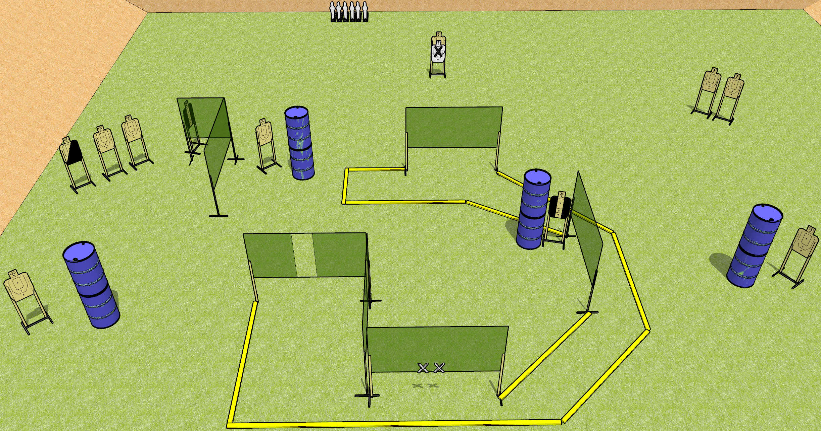
 | Dothan Gun Club – USPSA Match Just go Around Course Designer : Drew Coleman
Round Count 28 rounds 11 USPSA targets 6 mini poppers
Equipment List 11 wall feet 2 medium fault lines

Slide 2
Just Go Around
Written Stage Briefing
Just Go Around is a 28 round, 140 point, Comstock field course. There are 11 USPSA targets and 6 USPSA Mini Poppers. The best 2 hits on paper will score, and steel must fall to score. The start signal is audible.
Handgun start position is both hands touching X’s. Handgun is unloaded and holstered.
PCC start position is with muzzle touching either mark. Unloaded carbine is held with both hands, buttstock on belt, safety on.
On start signal, engage targets as they become available from within the shooting area.

